Slide 1


Vessel Centerline Extraction using Autoencoders Kyle Beggs Mechanical and Aerospace Engineering University of Central Florida, Orlando, FL, United States CAP 5516 – Medical Image Computing April 28, 2022

Slide 2
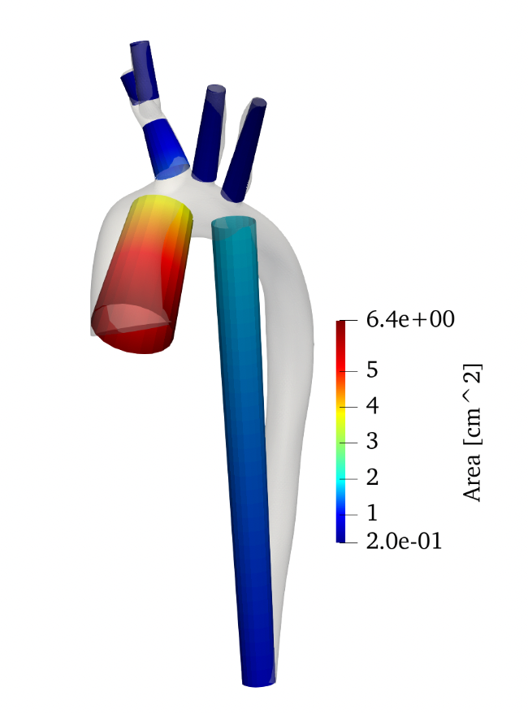
Motivation
Physicians and Surgeons highly interested in performing hemodynamics (blood flow) simulations
Computationally costly, around the time of training a ML model
Reduced-order methods can give accurate approximations
Need to extract the centerline of blood vessels segmentations

Slide 3
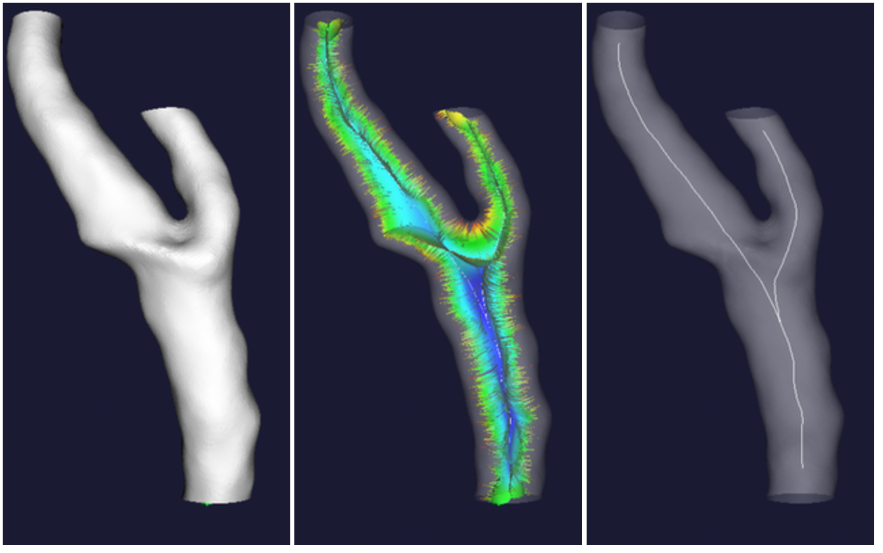
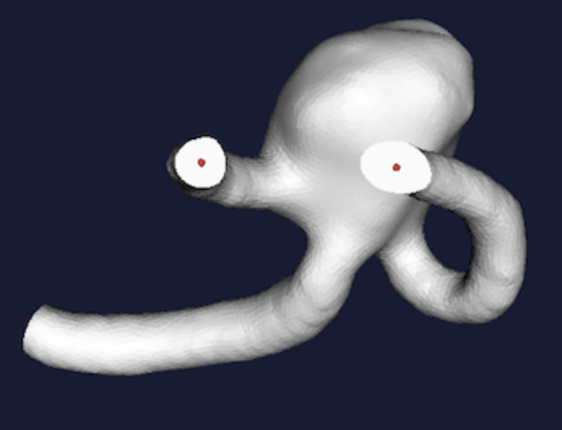
Traditional Methods
User places seeds at inlets/outlets
Wave propagation approach computes Voronoi diagram
Centerline is path on Voronoi diagram that
Images from VMTK which uses this approach based on Antiga, et al.

Slide 4
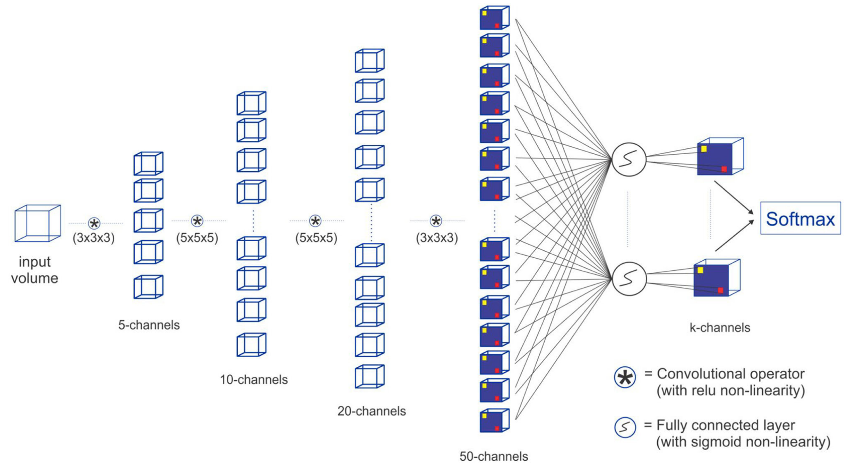
Current ML Appraoches
DeepVesselNet – Tettah, et al. (2021)
Fully Convolutional Network (FCN)
Extracts segmentation, centerline, and bifurcation points simultaneously
Uses Dice metric as loss, tries to match centerline pixels exactly
Extreme imbalance
Performs better than UNet and Vnet
Uses synthetically generated dataset (perfect targets)

Slide 5
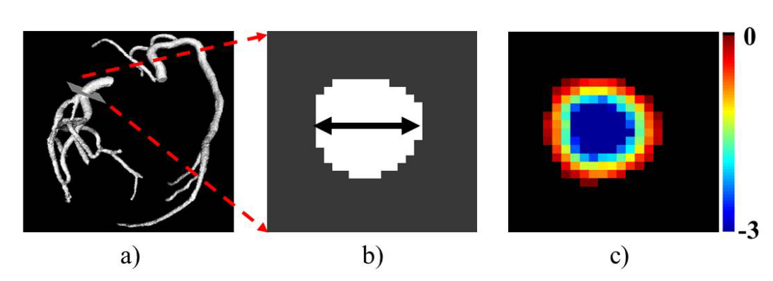
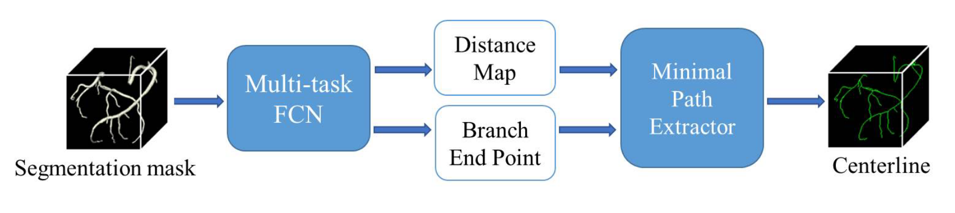
Current ML Approaches
DeepCenterline – Guo, et al. (2019)
Multi-task Fully Convolutional Network (FCN)
Uses real patient-specific coronary artery dataset
Trains using targets generated using traditional SOTA methods.

Slide 6
Objectives
There intends to be 2 main contributions from this work:
Provide guidance on using targets (centerlines) generated from current SOTA traditional (non-ML) methods vs synthetically generated or human-checked (perfect) targets.
Investigate the use of strided convolutions vs pooling in this context. Improve performance of centerline extraction using strided convolutions.

Slide 7
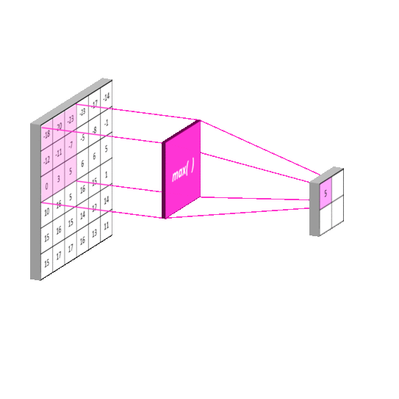
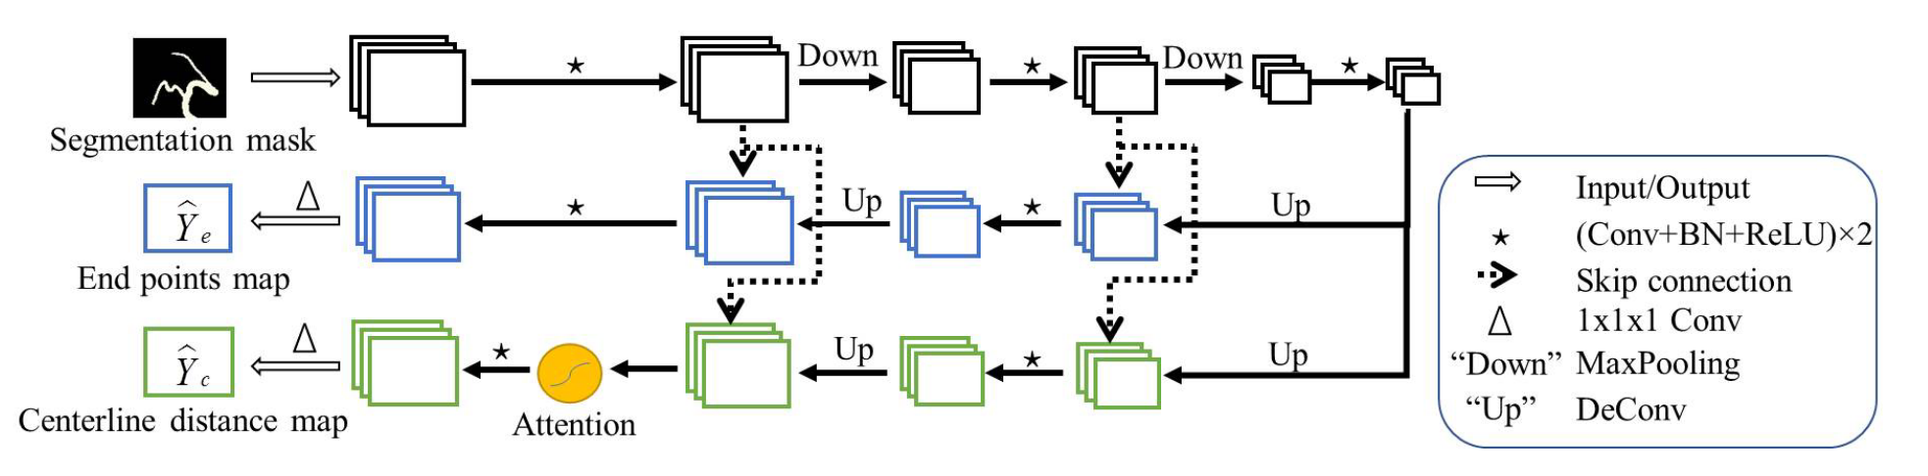
Our Approach
Based on DeepCenterline
Generate target centerlines using traditional SOTA
Replace convolutions with down/up pooling -> strided convolutions

Slide 8
Our Approach
Based on DeepCenterline
Generate target centerlines using traditional SOTA
Replace convolutions with down/up pooling -> strided convolutions

Slide 9
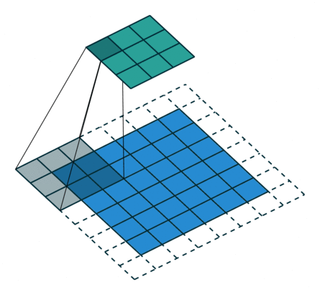
Our Approach
Output
Based on DeepCenterline
Generate target centerlines using traditional SOTA
Replace convolutions with down/up pooling -> strided convolutions
strided convolution
Input

Slide 10
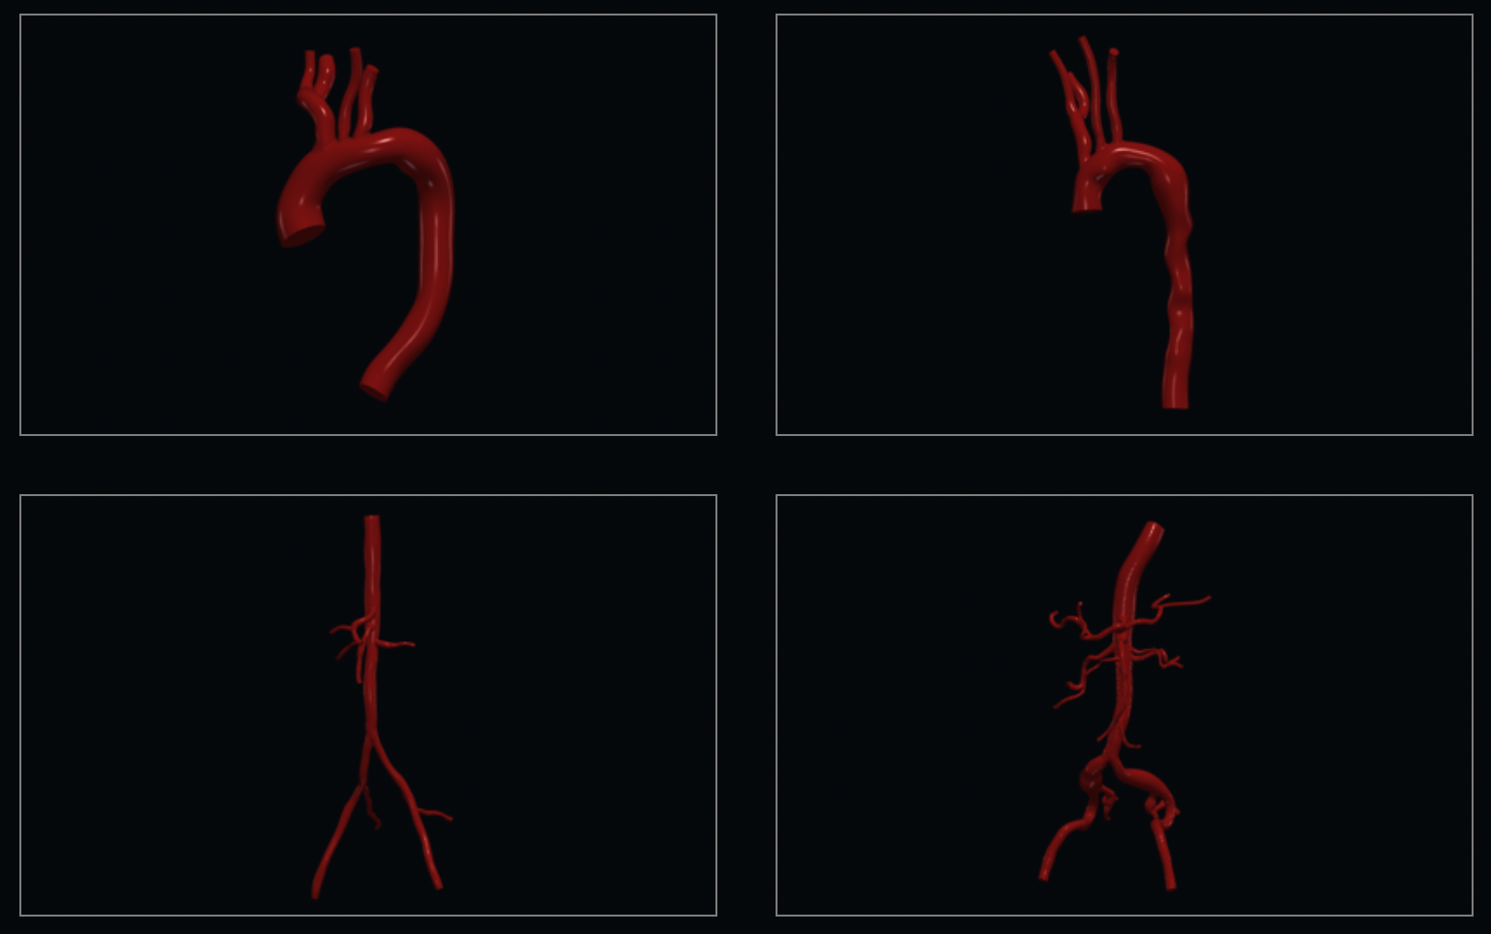
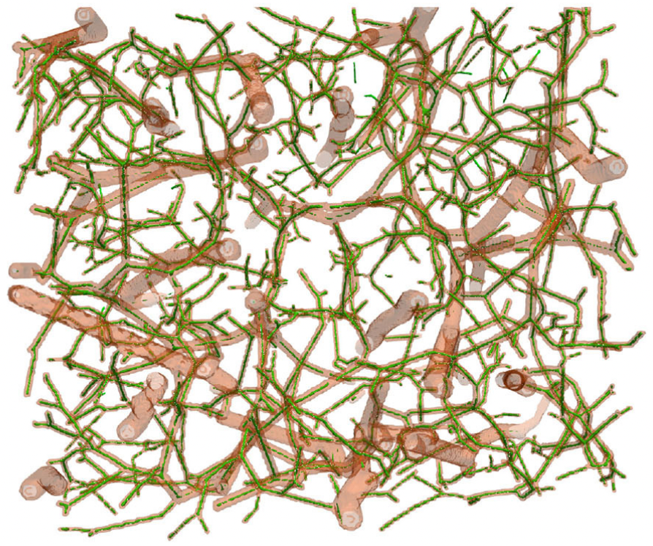
Datasets
DeepVesselNet
Synthetic – created using Murray’s Law
136 images of size (325, 304, 600)
Includes segmentation, centerline, raw image
Vascular Model Repository
Real patient data taken from MRI/CT
72 images of various sizes
Various parts (aorta, lower body, pulmonary)
https://www.vascularmodel.com/index.html
Notes:
.

Slide 11
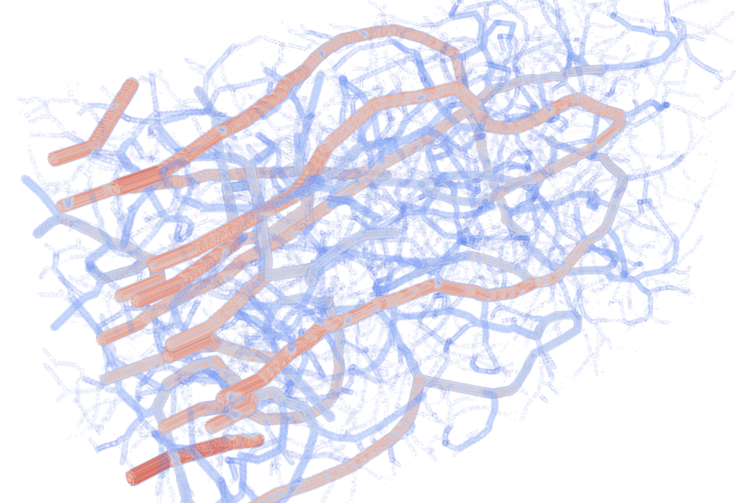
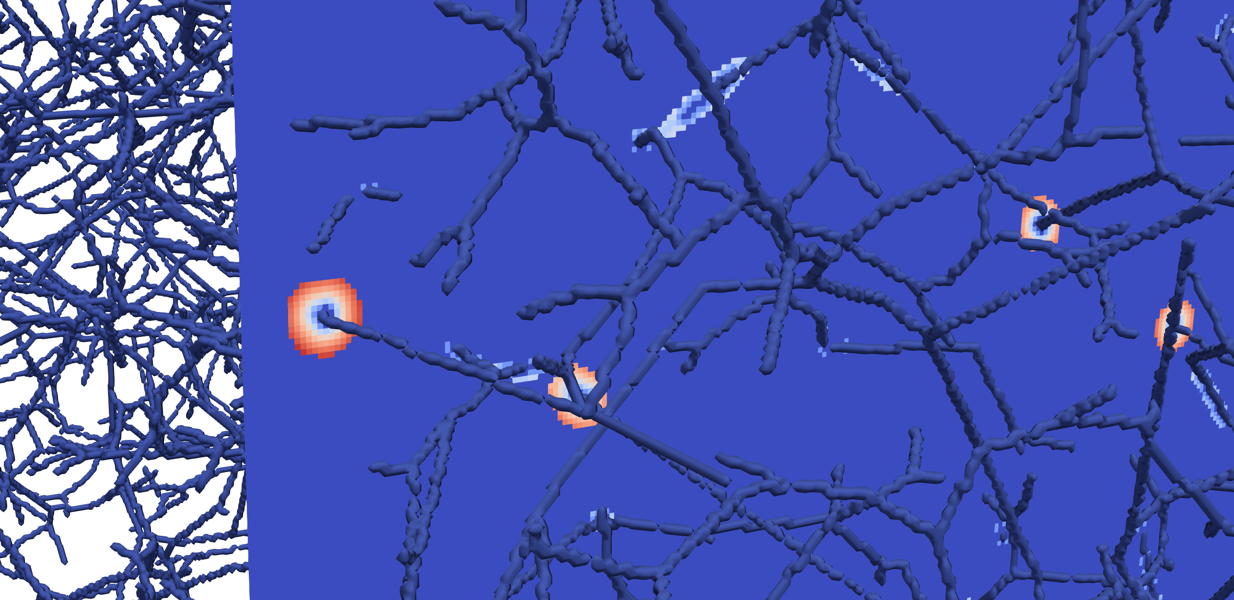
Preprocessing and Setup
Centerline Distance Maps
Generate targets via binary distance transform
Segmentation is a mask (binary)
Compute log(map) to further highlight center
Transforms
Random crop to (300, 300, 300)
Random flip along any axis
Training / Optimizer Settings
MSE loss only inside the segmentation mask
Cosine Annealing LR scheduler
Batch size = 6
Notes:
.

Slide 12
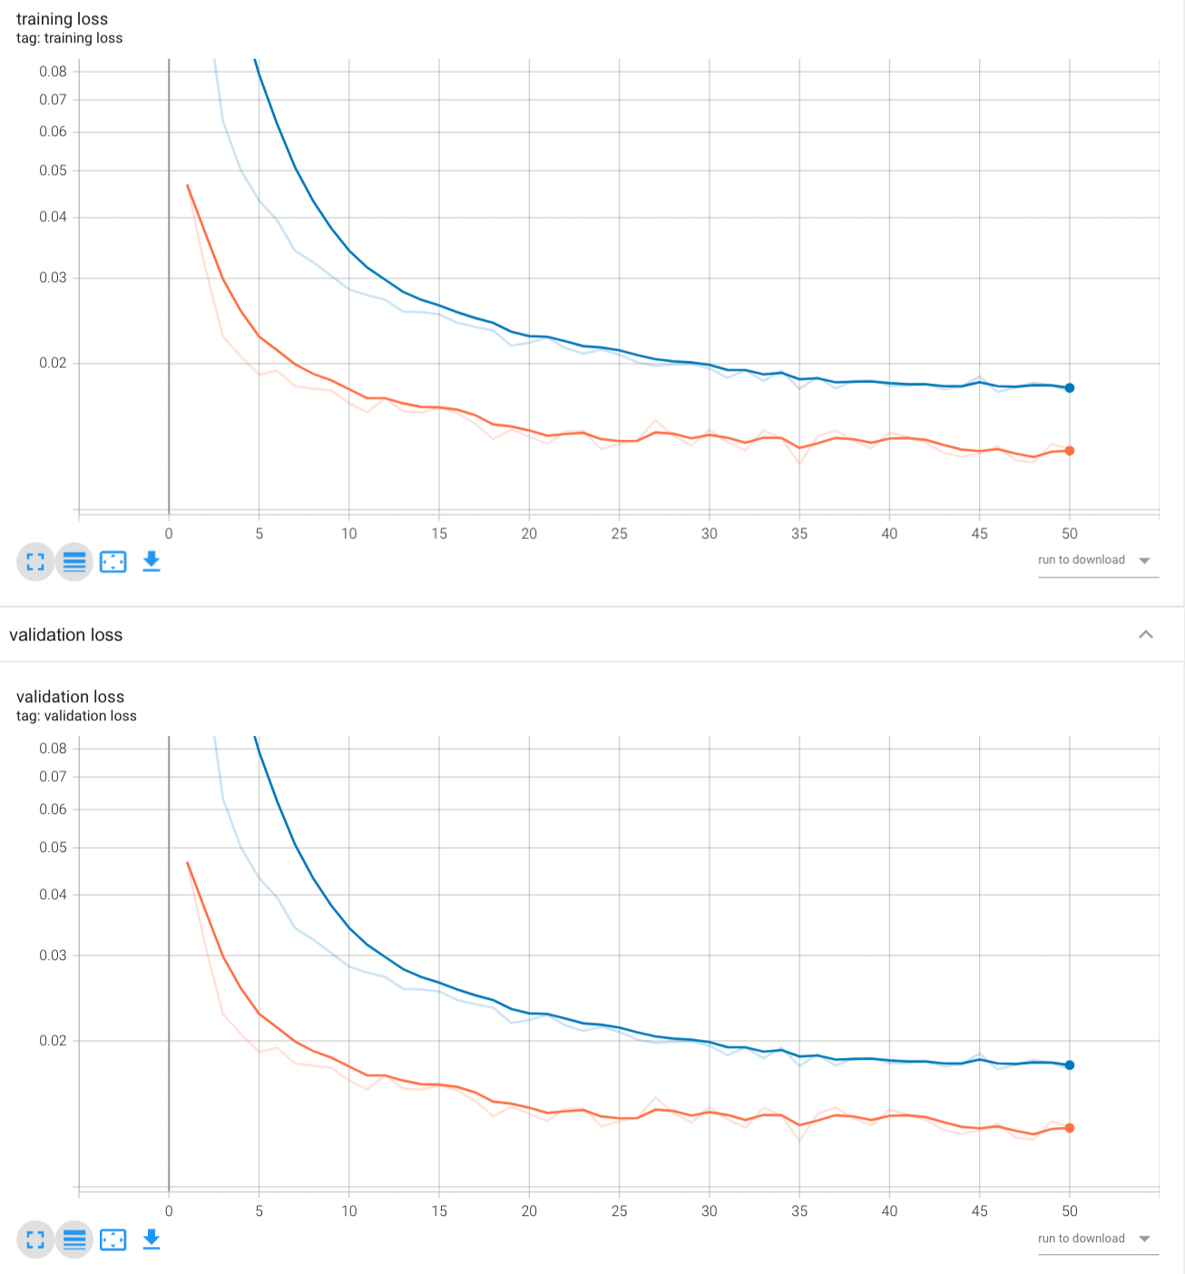
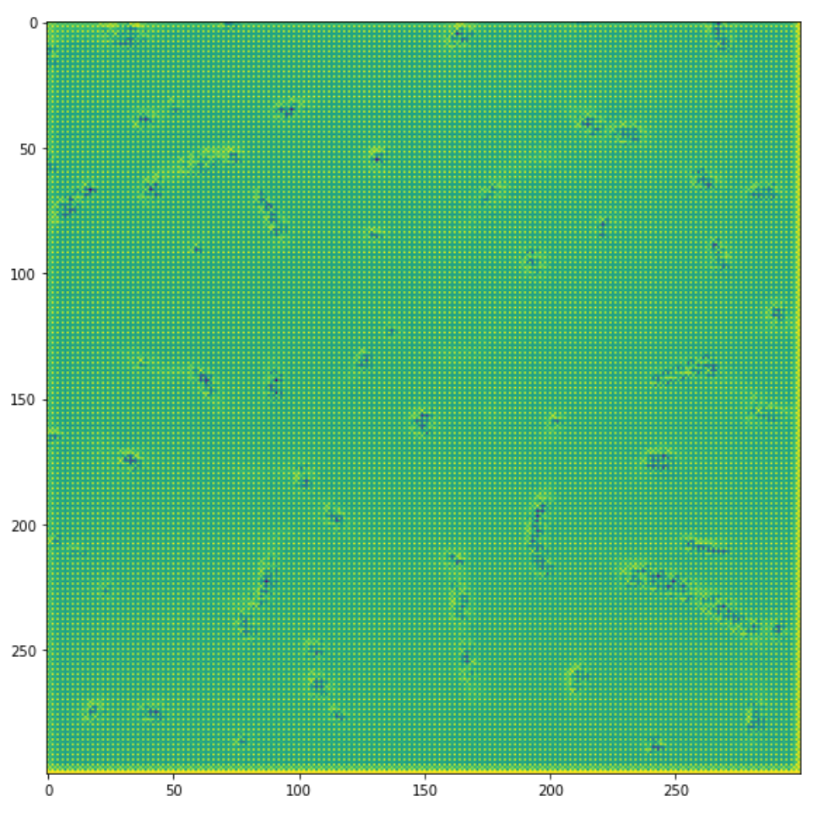
Results
Obviously, something is wrong!
Time to train 50 epochs
Striding: 1.8 hr
Pooling: 2.1 hr
Notes:
Not able to test impact of centerline target generation… obviously
For what its worth, striding performs better

Slide 13
Conclusion
Paper this is based off (DeepCenterline) has no code available
Implementation troubles
Not able to test effect of target generation (traditional SOTA vs. “perfect”)
Striding does seem to improve both loss and computational cost
Can’t trust completely though since something is wrong

Slide 14
Future Directions
Investigate “checkerboarding” in results
Make network deeper (although I tried my best to copy the paper)
Normalize data and add sigmoid functions

Slide 15

Questions?

